Slide 1


K.RAMAKRISHNAN COLLEGE OF TECHNOLOGY
(AUTONOMOUS), TRICHY.
DEPARTMENT OF
COMPUTER SCIENCE AND ENGINEERING
20CS5501 - DESIGN PROJECT-1
Batch No. : 13
Date : 06.12.2024

Slide 2
PLANT PULSE
Guided by Team
Mrs. A.Thenmozhi A Madhuvadhani S(811722104985)
Assistant Professor, CSE Rakshana G(811722104119)
Ranjani S (811722104121)

Slide 3
OBJECTIVE OF THE PROJECT
The primary objective of Plant Pulse is to enhance agricultural productivity by streamlining the process of leaf disease detection.
This project aims to provide a real-time, scalable, and accessible solution that reduces the reliance on manual methods. Additionally, Plant Pulse emphasizes the importance of ethical data handling by ensuring transparency, consent, and compliance with data privacy regulations throughout its development and deployment.

Slide 4
ABSTRACT
Plant Pulse is an advanced agricultural technology that utilizes machine learning (ML) and deep learning (DL) to revolutionize leaf disease detection. This innovative system leverages image processing techniques to analyze and classify plant leaf diseases with high accuracy and efficiency. By providing a hands-free, real-time solution, Plant Pulse eliminates the need for traditional manual disease inspection, offering a scalable and intuitive interface that caters to both large-scale farmers and small agricultural setups.The technology is particularly beneficial for improving crop health, boosting agricultural productivity, and ensuring global food security. Powered by frameworks like TensorFlow, Keras, and Streamlit, Plant Pulse combines user-friendly design with cutting-edge algorithms to deliver precise and actionable insights. It supports sustainable farming practices, enabling early detection and treatment of diseases, thus minimizing crop losses.

Slide 5
LITERATURE SURVEY
TITLE OF THE PAPER | AUTHORS | PUBLISHER | PAPER GIST | TECHNOLOGY USED
Leaf disease detection using Deep Learning | Teenu Sahasra M Sai Kumari S Sai Meghana S P. Rama Devi | IEEE Xplore, 2021 | Provides insights on the factors affecting agriculture | Custom Rules, Python
Deep learning models for plant disease detection and diagnosis | Ferentinos K.P | Computers and Electronics in Agriculture (2018) | Utilized various deep learning models, including CNNs, to diagnose plant diseases | Random Forest, k-NN
Deep Learning | Goodfellow, I., Bengio, Y., & Courville, A. | Deep Learning (2016) | Provides foundational understanding of DL techniques; Useful for developing new models | CNN
Frontiers in Plant Science | Mohanty, S. P., Hughes, D. P., | IEEE Xplore (2016) | Using deep learning for image-based plant disease detection | SVM, OpenCV

Slide 6
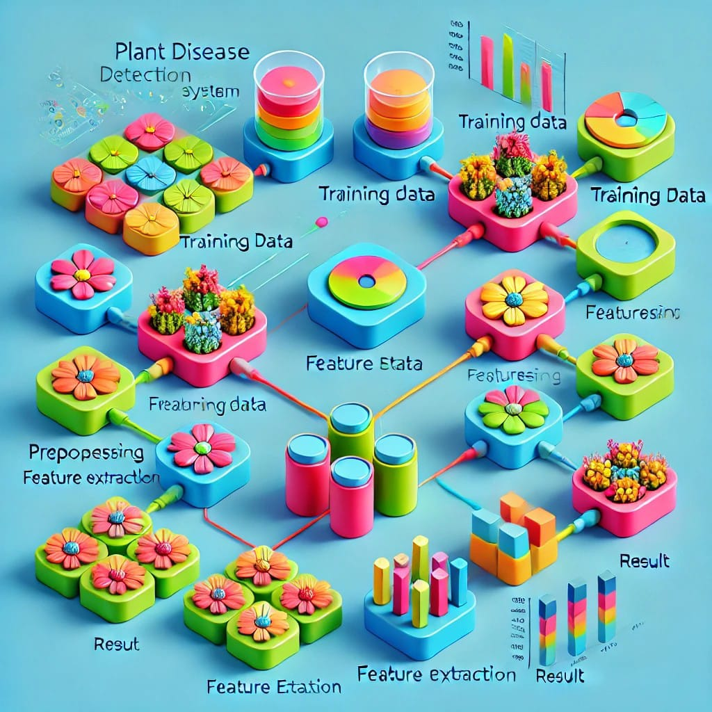
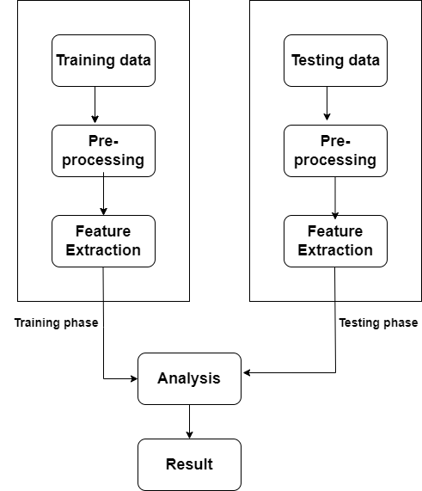
PROPOSED SYSTEM ARCHITECTURE

Slide 7
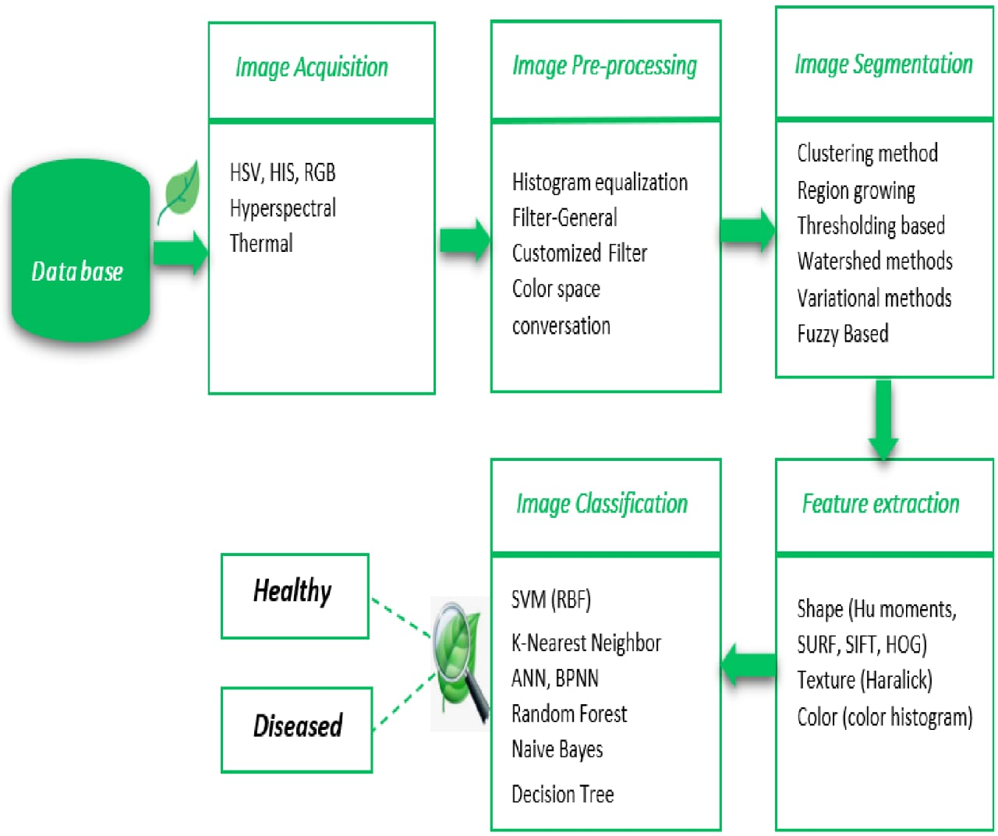
EXISTING SYSTEM ARCHITECTURE

Slide 8
SOFTWARE AND HARDWARE REQUIREMENTS
HARDWARE
SOFTWARE
RAM : 8 GB or more
Storage : Minimum 128 GB
Stable internet connection
Camera or smartphone
Processor: intel core i5
programming language:python 3.7 or above
Libraries and Framework: Tensorflow ,keras, pandas
Development Environment: vs code
GUI Framework: streamlit

Slide 9
MODULES
Data collection and Preprocessing
Model development
User Interface
Ethical Considerations
Development and Sustainability

Slide 10
SUMMARY OF MODULE-1
Data Collection and Pre-processing
In this project, images of diseased leaves were collected from real-time or recorded CCTV footage, making it a critical step. The collected images underwent pre-processing to enhance their clarity, including renaming, resizing, and labeling. This preparation ensures the images are ready for training a deep learning model. Proper pre-processing is essential to derive meaningful insights. The final processed images will be used to train and optimize the model for effective disease detection.

Slide 11
SUMMARY OF MODULE-2
Model development
During CNN training, the network is fed a large dataset of labeled images. It processes each image using randomly initialized weights, predicts a class, and compares its prediction with the actual label. This comparison calculates the error, which is used to update the network’s weights, improving accuracy over time.

Slide 12
SUMMARY OF MODULE-3
User Interface
The UI module of the Plant Pulse project, built with Streamlit, provides a simple and intuitive interface for users to upload plant leaf images for analysis. The system processes the image and displays the diagnosis, including the disease and its severity. Designed for accessibility, the UI ensures ease of use for farmers, agricultural experts, and researchers, offering clear feedback to help manage plant health effectively.

Slide 13
SUMMARY OF MODULE-4
Ethical Consideration
The ethical considerations module of the Plant Pulse project ensures responsible use of data and technology by prioritizing user consent, data privacy, and confidentiality. It safeguards personal and plant health data, adheres to privacy regulations, and promotes transparency, fairness, and accountability. This builds trust with users and supports sustainable agricultural practices.

Slide 14
SUMMARY OF MODULE-5
Development and sustainability
This module ensures the long-term viability and scalability of the Plant Pulse system by developing a robust, adaptable deep learning model and flexible infrastructure. It emphasizes eco-friendly technologies, cost-effectiveness, and accessibility to enhance agricultural productivity and support global food security. Designed for deployment in diverse agricultural settings, the system promotes sustainability and scalability while minimizing resource requirements.

Slide 15
RESULTS AND DISCUSSION
The Plant Pulse system accurately diagnoses plant diseases using deep learning models, providing clear feedback on disease type and severity. Data augmentation and image processing techniques improved model performance, while an intuitive user interface enables easy uploads and real-time diagnoses. Plant Pulse shows promise in automating plant disease detection, supporting sustainable agriculture. By using real-time or CCTV footage, it helps farmers detect diseases early. Data augmentation reduces overfitting, and challenges with dataset diversity can be addressed by expanding the dataset. The system is scalable, cost-effective, and supports global food security.

Slide 16
CONCLUSION
The Plant Pulse project successfully leverages advanced deep learning (DL) techniques to provide an efficient and user-friendly system for detecting and classifying leaf diseases. By integrating tools like Keras and TensorFlow, Plant Pulse ensures high accuracy in disease detection, helping farmers and agricultural experts monitor plant health in real-time. This project supports sustainable agriculture and global food security by reducing the reliance on manual disease identification, offering scalable solutions for improved crop management. Overall, Plant Pulse demonstrates how technology can significantly contribute to the future of agriculture.

Slide 17
THANK YOU

